Slide 1
Advertising Situation Analysis
https://twitter.com/Kevin_VOLone/status/1563933604849356801
Starting your research project
ADVT 340R – Fall 2022

Slide 2
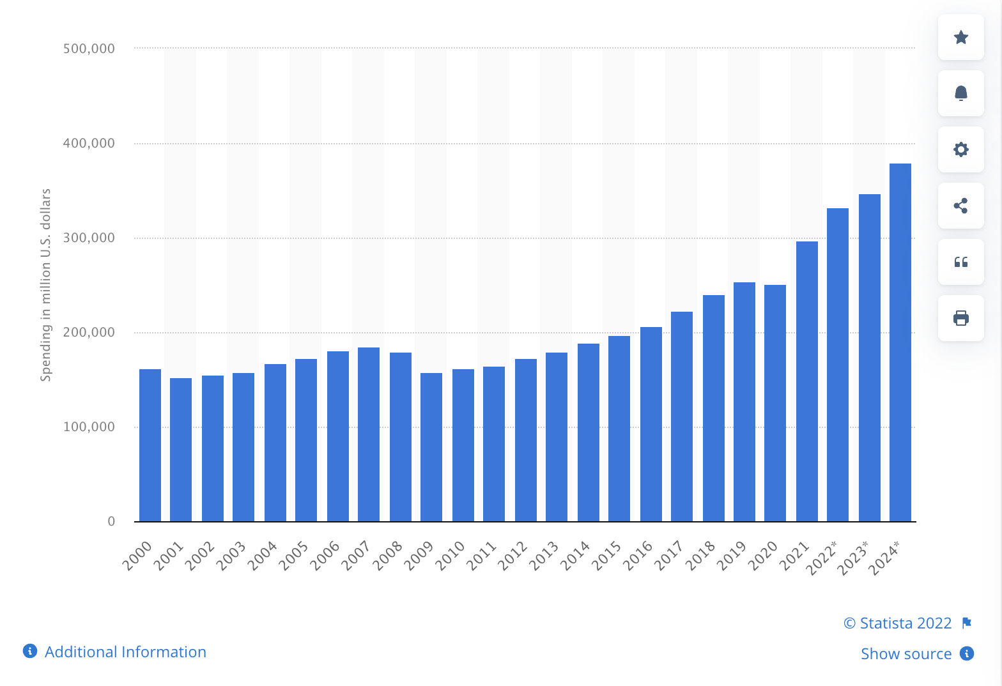
How much money do we spend on Advertising in the U.S.?

Slide 3
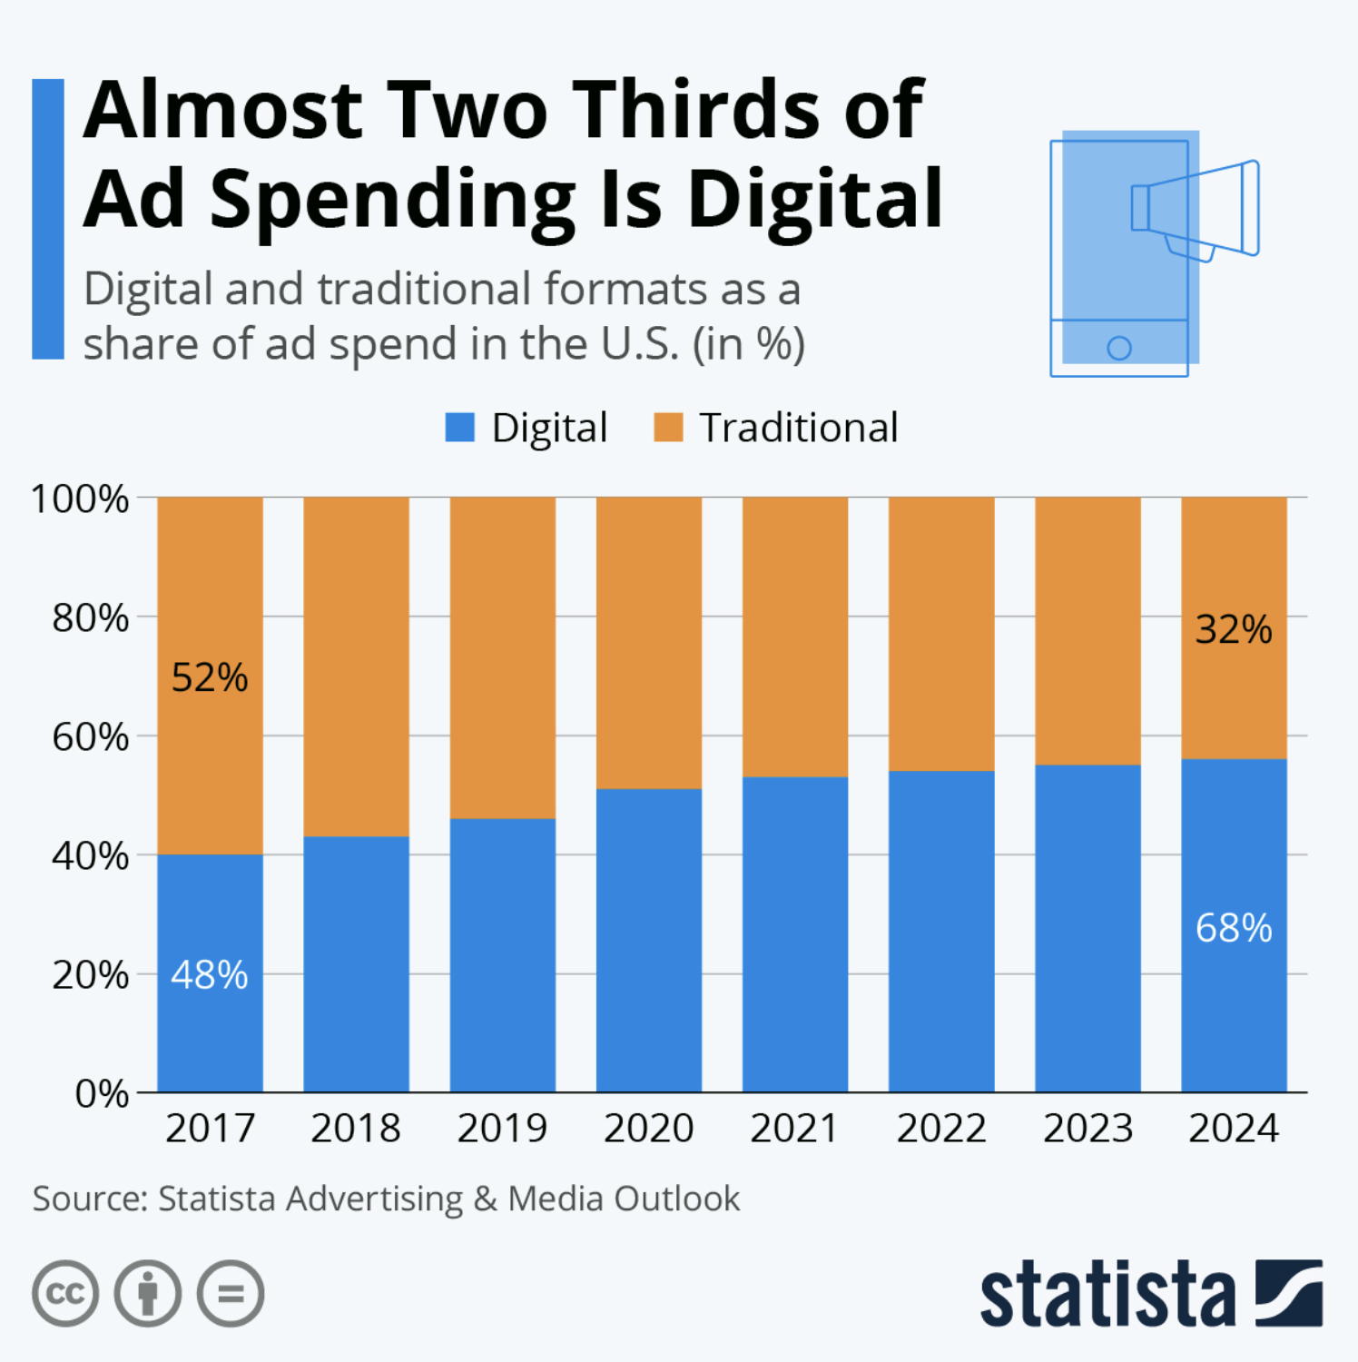
And what goes where?

Slide 4
What is the role of research?
“The systematic and objective process of gathering, recording, and analyzing data to aid in making informed communication decisions.”
Notes:
Systematic - There is a process, a “right” way to design and execute a research project. We acquire a collection of tools for our research toolbox that we consistently use. We don’t reinvent the wheel every time we begin a project.
Objective – we let the number, statistics, the “results” (qualitative) speak for themselves.
--We don’t spin or exaggerate the results simply to please the client or foster some agenda.
--In the planning and execution of a study we don’t consciously bias it to get the answer we want.

Slide 5
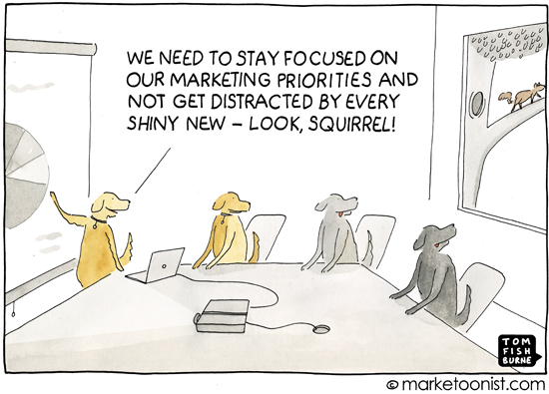
What does research do?
Four key decisions for communication strategy
Target Audiences
Forms of communication
Media Strategy
Message Strategy
Notes:
Target Audiences(s) – Primary, Secondary, Direct vs. Indirect
Forms of Communication – Adv, PR, PKG, Promotions, Direct Marketing
Message Strategy – What should we say about our product to each segment? What wants and needs does our product meet? Positioning.
Media Strategy – Where are our target market members? When and how do we reach them?

Slide 6
The 5 C’s of a situation analysis
Company/Product
Climate
Collaborators
Competitors
Customers
Notes:
Company – you’ve already started on this part with the “meet the client” homework
Climate – Social, Economic, Political, Technological, Environmental
Collaborators – Suppliers, Distributors, Influencers, etc.
Competitors – Primary, Secondary, Indirect
Customers - Segment, size, need, decision making, attitudes, where are they now

Slide 7
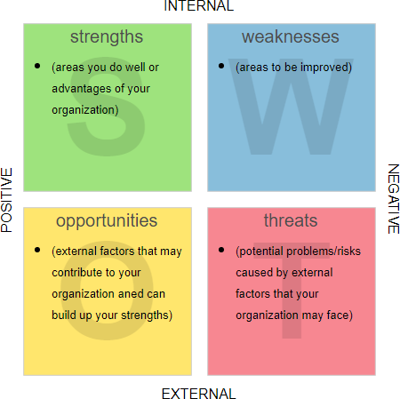
The summary of the Situation Analysis
The SWOT Analysis
Strengths
Weaknesses
Opportunities
Threats

Slide 8
We are breaking this up into 4 portions
Climate
Collaborators
Product
Industry Overview
Client/Competitors
Company
Competitors
Consumer Analysis
Consumer
SWOT Analysis
The Swot Analysis

Slide 9
Company/Product
Company includes
History
Goals and Objectives
Branding
Unique Selling Points
And Product Information

Slide 10
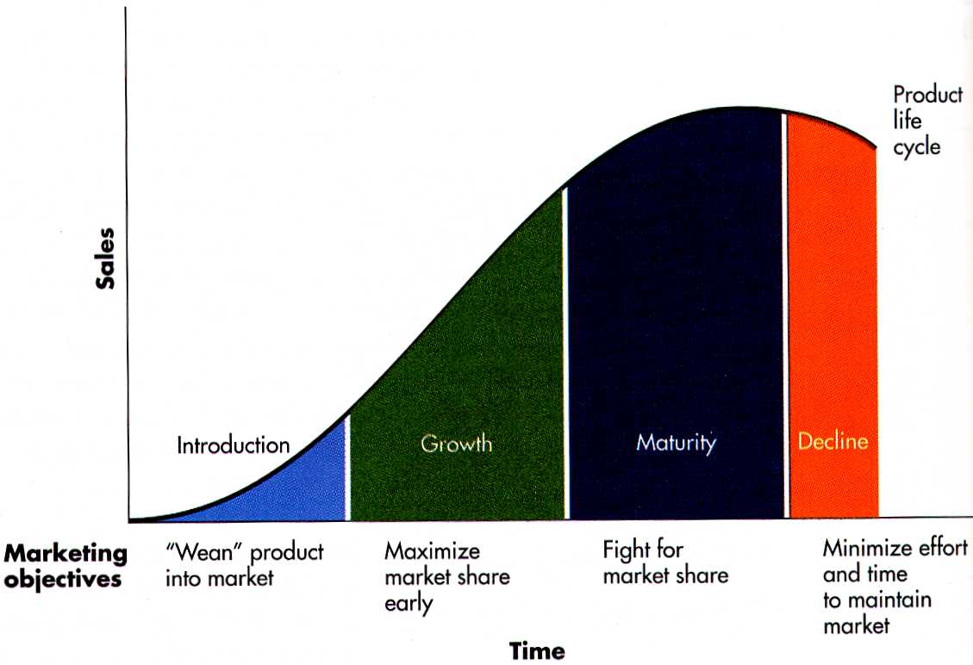
Product Life Cycle

Slide 11
How do you determine where a product is in the cycle?
Age
Revenue
Level of adoption
Number of Competitors
Novelty

Slide 12
Introduction Stage
Young
Little to no revenue
High cost to produce/sell
Low Awareness
1, maybe a few major players
No Strong Attitudes

Slide 13
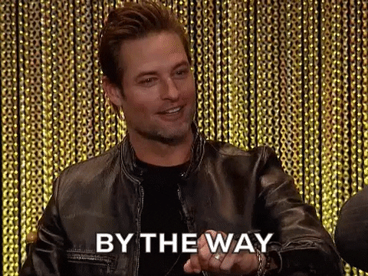
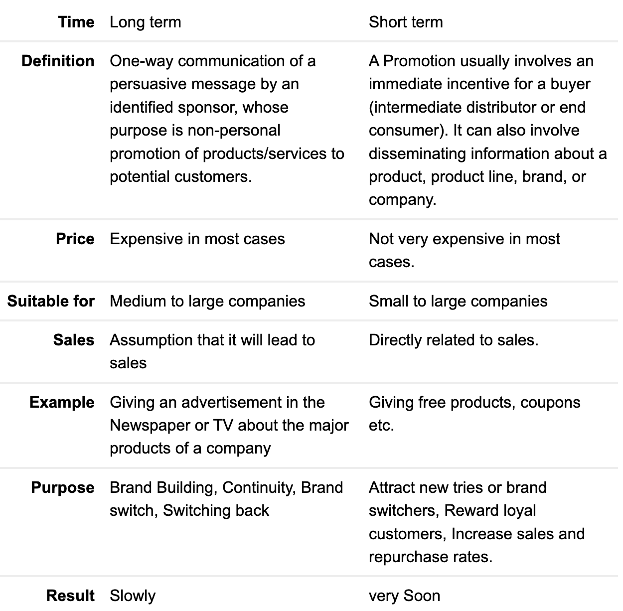
ADVERTISING vs. PROMOTION
Advertising is a kind of promotional activity to sell goods or services to a target audience.
In fact, advertising is one of the oldest forms of marketing or promotion, trying to influence the target audience to buy or do something specific.
It is also how sellers communicate with potential buyers about a product or service.

Slide 14
Introduction Stage
Advertising Objectives
Promotion Objectives
Create awareness and knowledge among early adopters
Establish Unique position (if not first)
Generate trial
Promote to Retailers for shelf space
Promote to consumers to stimulate trial/impulse purchase

Slide 15
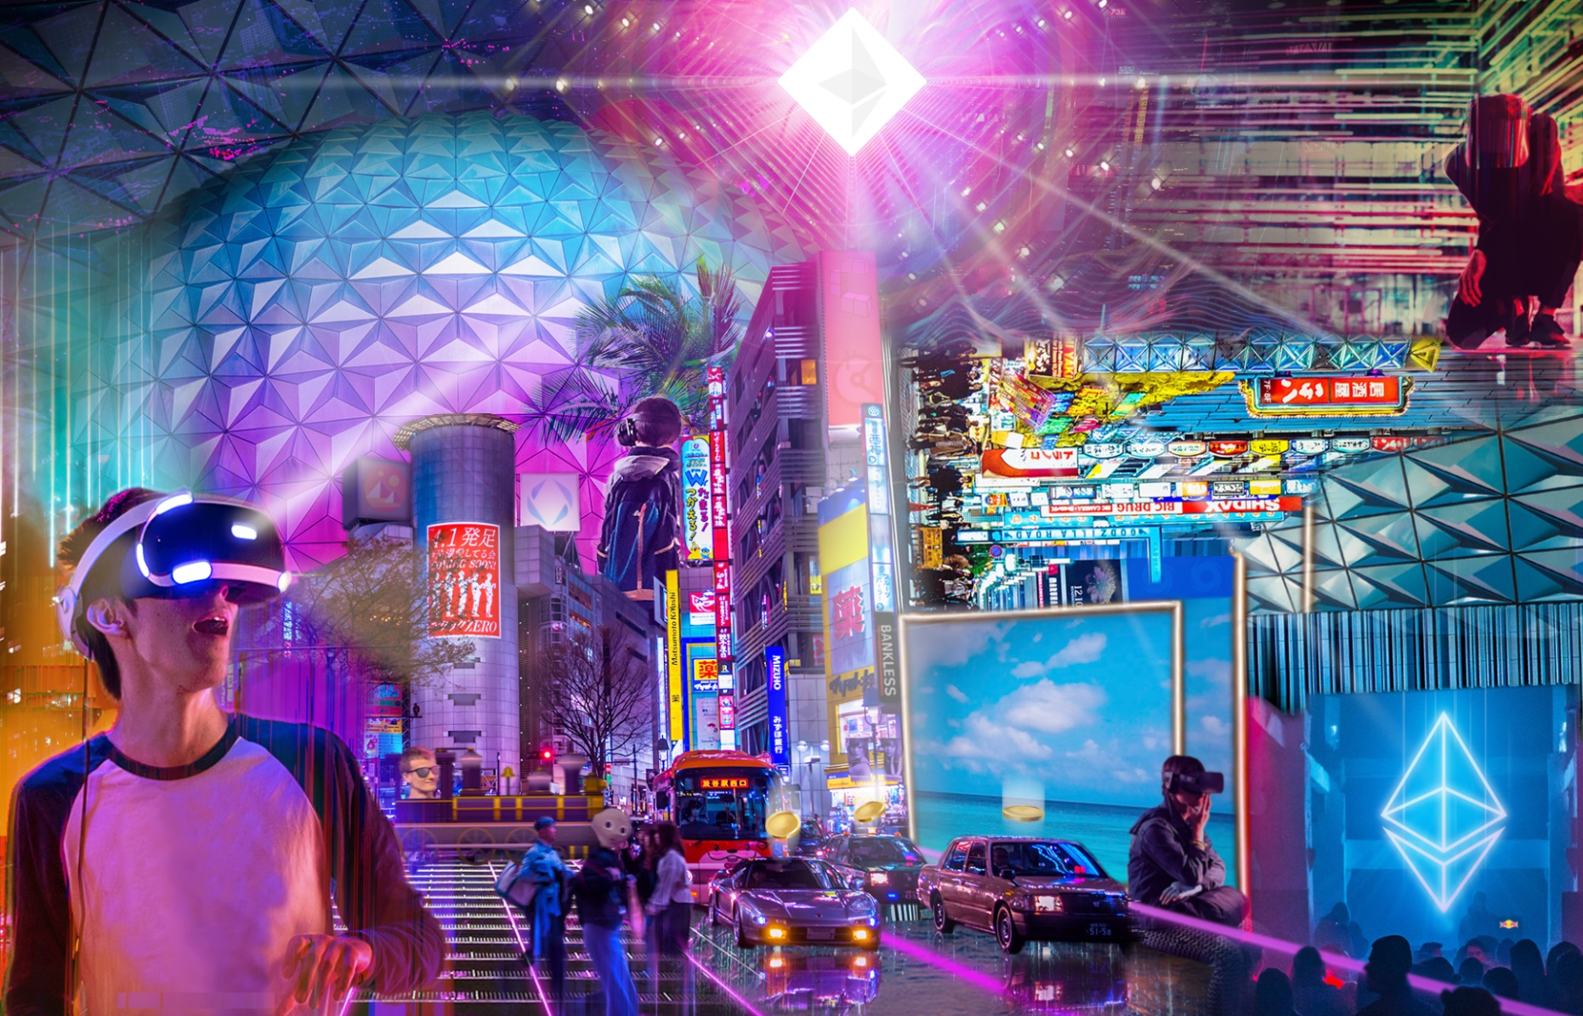
Metaverse Example
Companies have started to try to introduce concepts associated with a “metaverse” an online world that mirrors physical world aspects.
Companies such as Epic Games, Facebook, and Microsoft have started designing aspects of their own metaverses.
The concept is weird or foreign to many people, but the focus by companies is on informing and establishing a unique position.
How’s it going for Zuckerberg?

Slide 16
MENTAL BREAK!
Was this a peloton instructor…
or a cult leader?

Slide 17
MENTAL BREAK!
Was this a peloton instructor…
or a cult leader?
“Pain’s not bad, it’s good. It teaches you things. I understand that.”

Slide 18
MENTAL BREAK!
Was this a peloton instructor…
or a cult leader?
“Pain’s not bad, it’s good. It teaches you things. I understand that.”

Slide 19
MENTAL BREAK!
Was this a peloton instructor…
or a cult leader?
“If Britney can get through 2007, you can get up this hill.”

Slide 20
MENTAL BREAK!
Was this a peloton instructor…
or a cult leader?
"If Britney can get through 2007, you can get up this hill.”

Slide 21
Picking up on Wednesday…
Product Life Cycle

Slide 22
Growth Stage
Still relatively young
Revenue increasing but probably not profitable
Price starts decreasing
News coverage begins to increase
Major increase in number of competitors
Number of users skyrockets
Attitudes/memes begin to form

Slide 23
Growth Stage
Advertising Objectives
Promotion Objectives
Generate Demand
Emphasize unique position
Specialized Media Mix
Promote to Retailers shelf space, features, and exclusives
Promote to consumers to encourage trial and branding

Slide 24
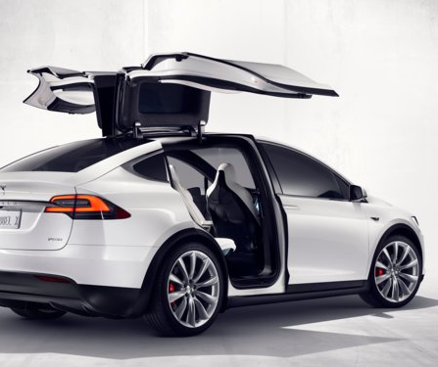
Tesla example
Lowered costs to promote adoption
Sportier and “cooler” than competitors
Gave away engine designs to move industry towards growth after name became huge
Began experimenting in solar and power conversion technology.

Slide 25
Maturity Stage
Mature
Revenue starts to top out
Profit becomes key
Saturated Awareness
IPOs and Investor focus
Fewer competitors with minor differences
Attitudes have formed and people are in camps

Slide 26
Maturity Stage
Advertising Objectives
Promotion Objectives
Defend Position
Take share from competitors
Defined Media Mix
Promote to Retailers to support them
Promote to consumers to encourage switching
Promote new uses

Slide 27
Maturity Stage
Advertising Objectives
Defend Position
Take share from competitors
Defined Media Mix
Promotion Objectives
Promote to Retailers to support them
Promote to consumers to encourage switching/upgrading
Maintain position in consumers’ minds
Differentiate on intangible differences
Stress new use occasions
Unique selling proposition is very important here
Strategies

Slide 28
Streaming Example
Prices are rising after a decade of being in the red
Focus on Owned shows
Start making entertainment/tech acquisitions
Start bundling services (like cable did)

Slide 29
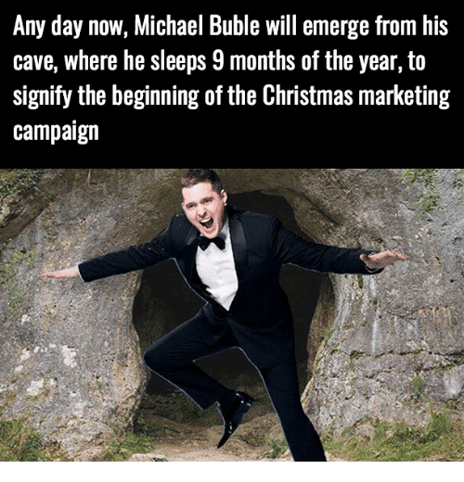
Seasonality
Sales/Consumption is not steady throughout the year
Looking at week, month, or quarterly sales will let you spot seasonality
Peaks and valleys
Not everything is seasonal

Slide 30
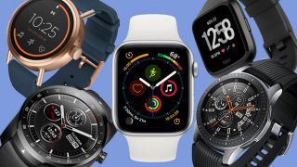
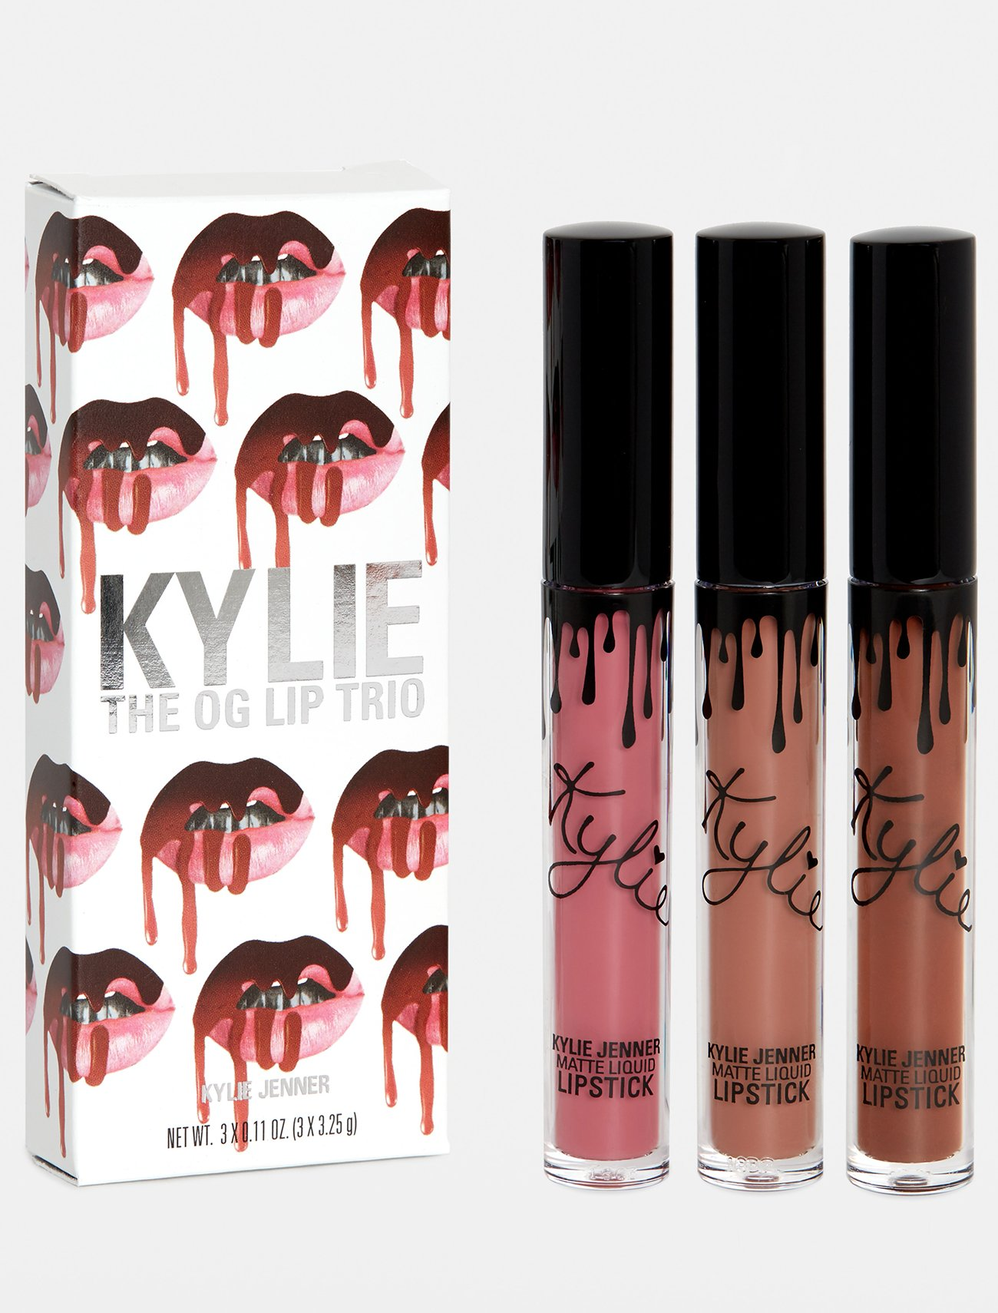
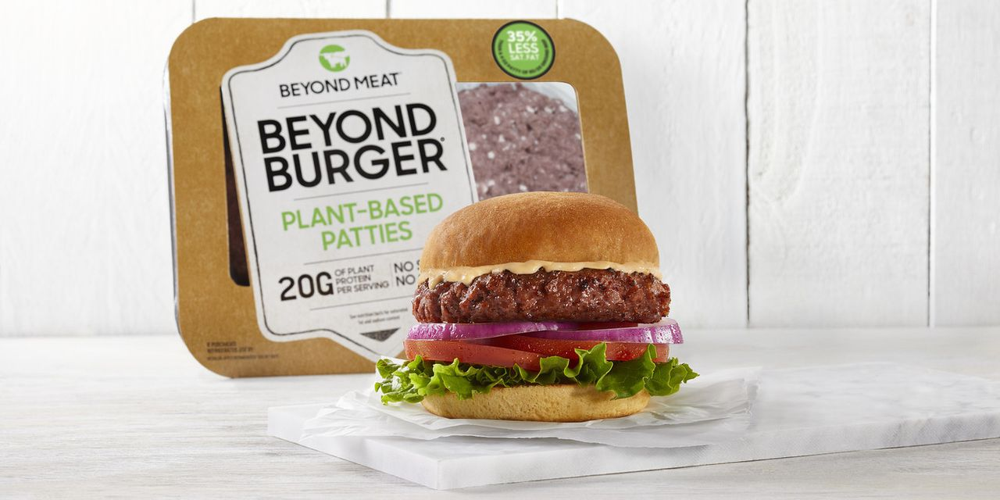
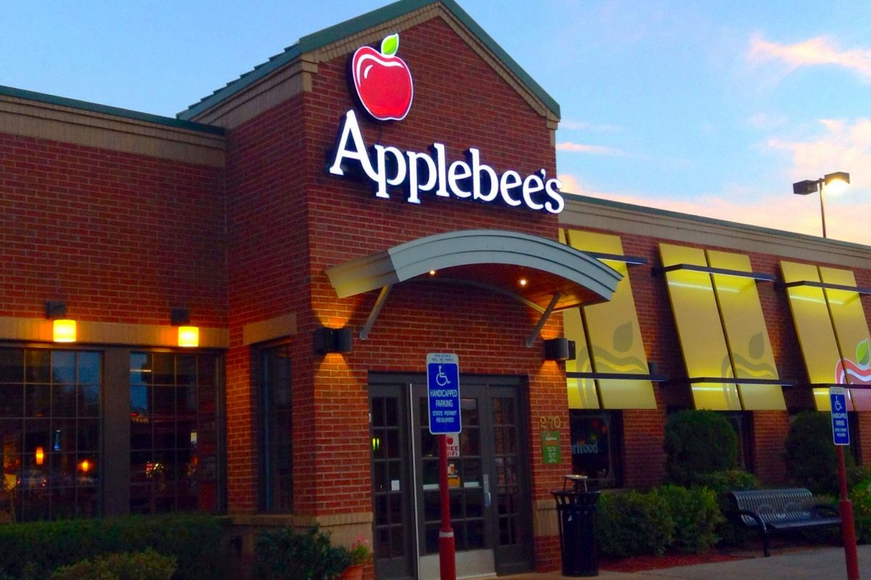
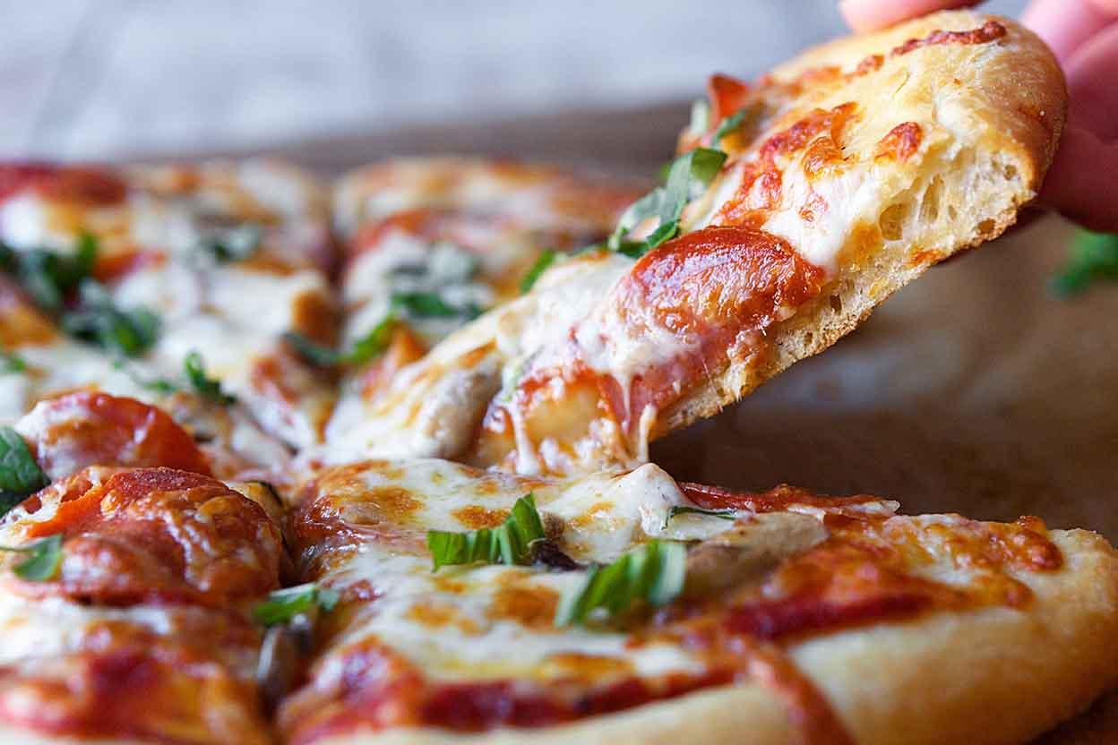
Product Life Cycle

Slide 31
Climate: SEPTE
Social
Economic
Political
Technological
Environmental

Slide 32
Social/Cultural
Look for External Drivers and Market Factors
What makes people want to buy this product?

Slide 33
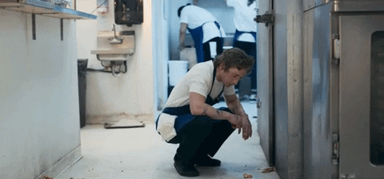
External Drivers and Market Factors:
Dining Example
How would an ad look if it was based on….
Trends in dining
Organic
Creativity
Healthy choices
Parents don’t want to cook
Kids influence where the family eats
Are they eating in front of the tv or at a table?
Delivery/Order ahead

Slide 34
MENTAL BREAK!
Was this a peloton instructor…
or a cult leader?

Slide 35
MENTAL BREAK!
Was this a peloton instructor…
or a cult leader?
“Treat your body like it belongs to someone you love.”

Slide 36
MENTAL BREAK!
Was this a peloton instructor…
or a cult leader?
“Treat your body like it belongs to someone you love.”

Slide 37
MENTAL BREAK!
Was this a peloton instructor…
or a cult leader?
“Love is the only weapon.”

Slide 38
MENTAL BREAK!
Was this a peloton instructor…
or a cult leader?
“Love is the only weapon.”

Slide 39
OK
Last few slides!

Slide 40
Economic
GDP
Measure of the health of the overall economy. Percentage
Disposable Personal Income
Consumer income – taxes
Not exactly accurate (rent, loans, cost of living, tuition, etc.)
Consumer Confidence
Poll of 5000 HH
2 components situation and expectations – 90 and above is good
Consumer Price Index
Measures the changes in commodities
Fuel, oil, electricity, utilities, telephone, food
Unemployment Rate
Number of working age people searching for employment as a percent of those employed
Tariffs
Taxes placed on imports from other countries

Slide 41
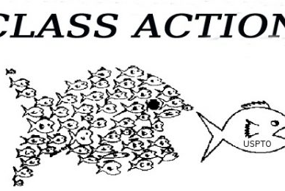
Political/Legal
Government Regulation
FTC, FDA, FCC, SEC, EPA etc.
B2B lawsuits
Patent lawsuits, breach of contract
C2B lawsuits
Class Action lawsuits, employment lawsuits

Slide 42
Technological
Knowledge that satisfies wants and needs
Impact of technology on demand
Implication for reaching consumers
Ease of process

Slide 43
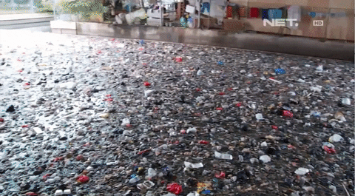
Environmental
Or
Raw Materials
Energy Costs
Pollution
Sustainability

Slide 44
Now what?

